Slide 1

SQL Analysis Report: Global AI Job Market & Salary Trends (2025)
A Report
presented by
Ruqayyah Odufuye-Rufai

Slide 2
PREAMBLE
This dataset provides an extensive analysis of the artificial intelligence job market with over 15,000 real job postings collected from major job platforms worldwide. It includes detailed salary information, job requirements, company insights, and geographic trends. The Dataset contains 15000 rows and 19 columns. This Dataset was also gotten from kaggle.com

Slide 3
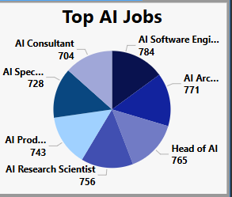
Top 10 AI Job Titles
We identified the most frequently advertised AI-related roles by analyzing job titles that include the keyword “AI.” The SQL query grouped and counted these titles, then ordered them by frequency.
Insight: The most common AI job titles include roles like AI Engineer, Machine Learning Specialist, and AI Researcher, indicating strong demand in these areas.

Slide 4
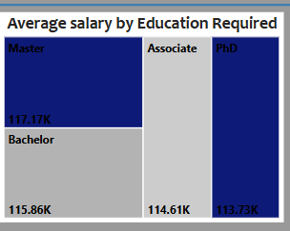
Average Salary by Education Level
We calculated the Average salary (in USD) for each education level by grouping the data by education level and applying the AVG() function.
Insight: The Master’s level had the highest average salaries while the PhD had the lowest average salaries though in some cases, top-performing bachelor’s-level professionals may earn competitive compensation.

Slide 5
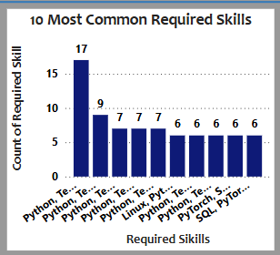
Top 10 Most Common Required Skills
We examined job postings for the most frequently mentioned required skills. Where skills were stored as comma-separated strings, we split them and counted their frequency.
Insight: Skills like Python, SQL, Machine Learning, TensorFlow, and Data Analysis dominate the top 10, reinforcing their importance in AI and data-related roles.

Slide 6
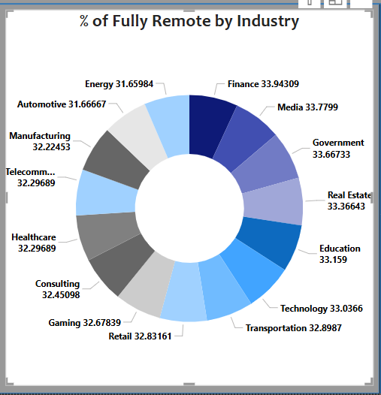
Percentage of Fully Remote Jobs by Industry
We evaluated the percentage of jobs marked as fully remote (remote ratio = 100) within each industry. This was achieved by dividing the count of fully remote jobs by the total number of jobs per industry.
Insight: Industries such as Technology, Software, anddata science exhibitw the highest share of fully remote roles, reflecting a strong shift toward remote-friendly work in digital sectors.

Slide 7
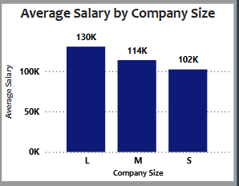
Average Salary by Company Size
We compared the average salaries across company sizes — Small (S), Medium (M), and Large (L). This analysis used the AVG() function grouped by the company size field.
Insight: Large companies (L) offer the highest average salaries, likely due to greater resources and more complex project scopes, though medium-sized companies may offer more flexible roles or perks.

Slide 8
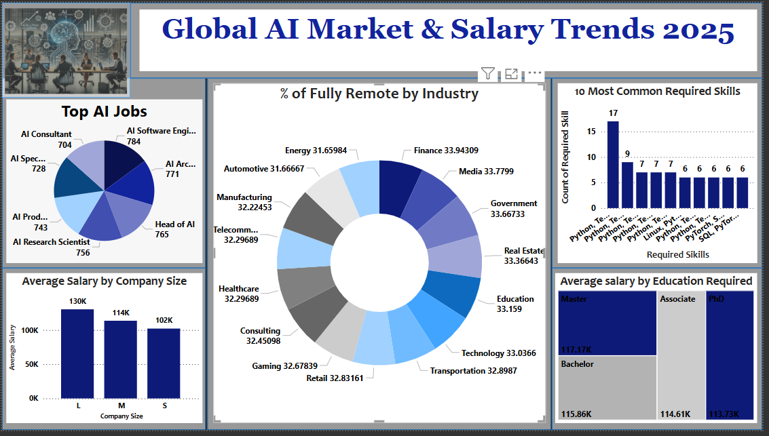
Overall Summary
This analysis reveals key trends shaping the global AI workforce in 2025:
- AI job demand is expanding rapidly, especially in engineering and research roles.
- Advanced education boosts earning potential.
- Remote work is well-established in tech-forward industries.
- Python and machine learning tools remain essential skills.
- Larger firms often lead in salary offerings but smaller companies may compete on flexibility.

